Slide 1

COVID19
DAILYP-REPORT
BY :
Nasser Alshehri

Slide 2
Presentation Outline:
conclusion
DATA
Tools
Introduction
Data Visualization
Problem understanding
COVID-19 | 2020

Slide 3

Introduction
A new coronavirus designated 2019-nCoV was first identified in Wuhan, the capital of China's Hubei province.
People developed pneumonia without a clear cause and for which existing vaccines or treatments were not effective.
The virus has shown evidence of human-to-human transmission.
COVID-19 | 2020

Slide 4

Problem understanding
Overview:
Data provided by Kaggle has been used in this project
COVID19 Daily Report included in the data
Problem statement:
The purpose of the analysis is to know the increase and decrease in Corona cases in all continents around the world for Knowing in each country what are the decision about Quarantine , also, pharmaceutical manufacturers benefit to be exported to each country according to the infected cases
COVID-19 | 2020

Slide 5
DATA :
The dataset Contains 14316 Rows and 9 Columns:
active : Number of Active cases
confirmed : Number of Confirmed Cases
country : country
date : Date
death : Number of Deaths
latitude : latitude
longitude : longitude
recovered : Number of Recovered cases
continent : Continent of the country

Slide 6

Total Number of Cases
195,960,149
Worldwide as of January 2020 until July 2020 .

Slide 7
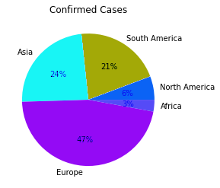
Data Visualization
:umber of Cases
Observations :
continent has the most confirmed cases of coronavirus Europe .
continent has the least confirmed cases of coronavirus North America , Africa

Slide 8
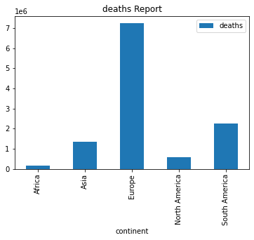
Data Visualization
:umber of Cases
Observations :
continent has the lowest number of deaths from the Corona virus
is Africa
continent with the most deaths from the Corona virus is Europe

Slide 9
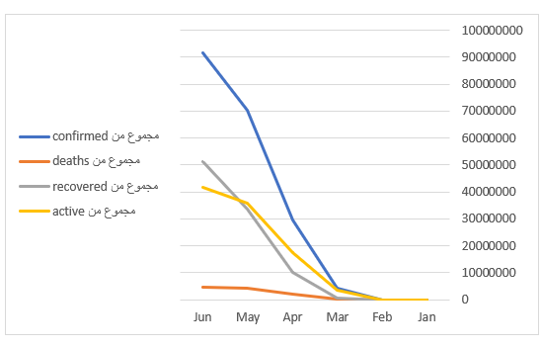
Data Visualization
:umber of Cases
Observations :
Cases increased from January to June from deaths, recovered, active and Confirmed

Slide 10
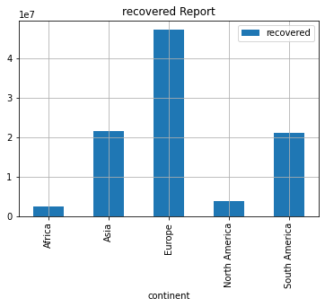
Data Visualization
:umber of Cases
Observations :
many people have recovered from the Corona virus around the world from 1/1/2020 to 29/6/2020

Slide 11

As of July 2020
conclusion
know the increase and decrease in Corona cases in all continents around the world and Deaths , Actives , recovered as of January 2020 until July 2020 .

Slide 12
Thank you

